Slide 1
Status Report #12
Items
2020. 01. 23 (Thu)
B4 Tomomasa FUJIWARA
JPS abstract submitted
Final-term reports
Progress of ToF data analysis
Bias dependence
Check time walk correction parameters.
Restart ToF data taking
Set up test bench at 6F
Data taking using cosmic-ray

Slide 2
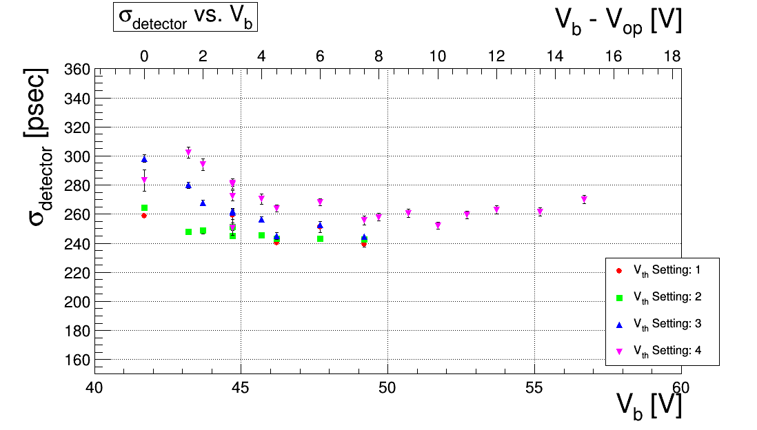
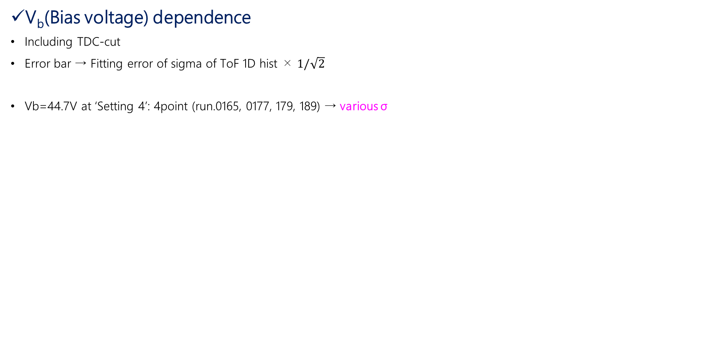
Progress of ToF data analysis (experiment at ELPH)
V_{b}(Bias voltage) dependence
Including TDC-cut
Error bar → Fitting error of sigma of ToF 1D hist × $1/\sqrt{2}$
Vb=44.7V at ‘Setting 4’: 4point (run.0165, 0177, 179, 189) → various σ
Setting | R1 | R2 | L1 | L2
1 | -31.1 | -25.0 | -24.4 | -34.7
2 | -51.1 | -45.7 | -44.3 | -54.7
3 | -100 | -100 | -90 | -101
4 | -150 | -150 | -145 | -151
unit: mV

Slide 3
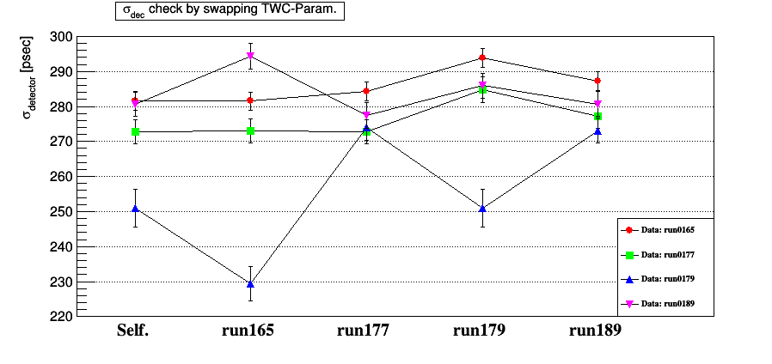
Progress of ToF data analysis (experiment at ELPH)
Check about Time walk correction parameter
For run data of Vb=44.7V & threshold setting 4,
check timing resolution by swapping parameters of time walk correction.

Slide 4
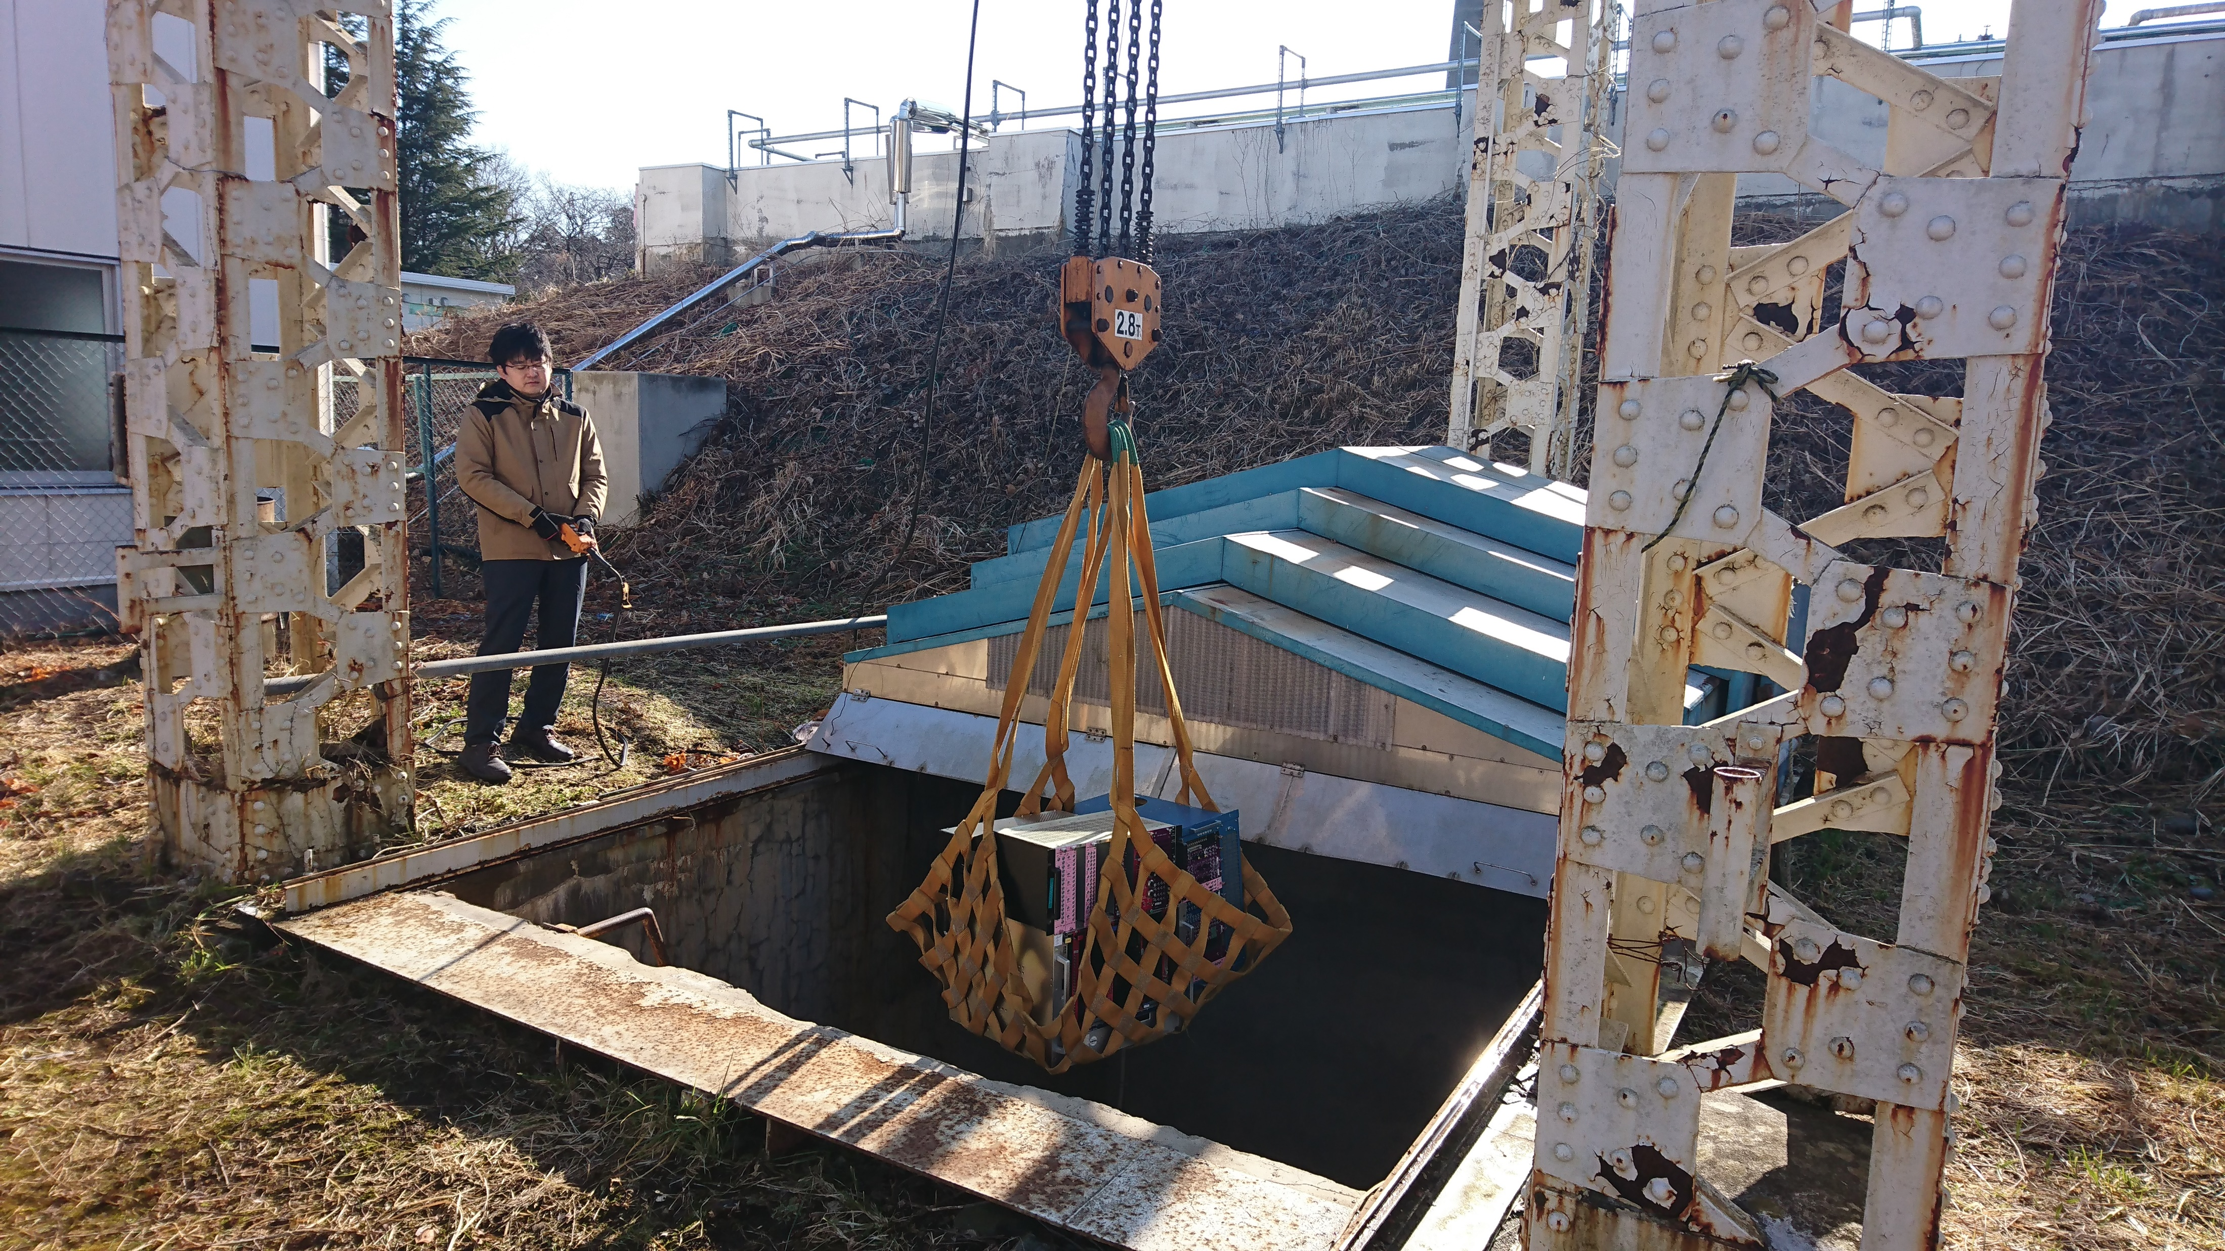
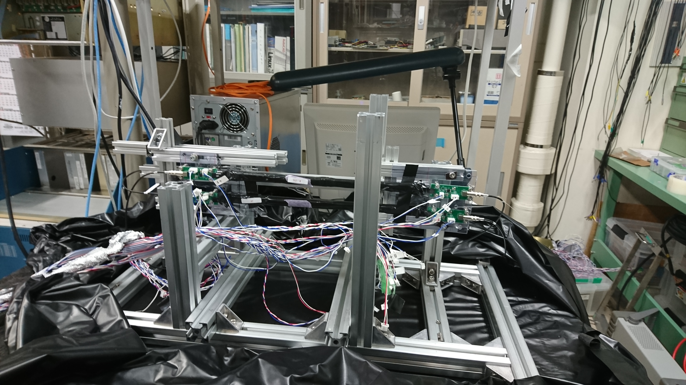
Restart ToF data taking
On Tuesday, Brought back NIM modules from ELPH
with Nagao-san, Toyama-san & Akiyama-san
Yesterday (Wednesday), constructed testbench at 6F with Nagao-san

Slide 5
Restart ToF data taking
Signal Check of ToF
Using β-ray source, via Pmamp,
Bias voltage: 44.7V
Data at 6F (before Beamtime)
Data at ELPH (Bias: 44.7V)
Ch | R1 | R2 | L1 | L2
Pluse | -600 | -450 | -450 | -600
Ch | R1 | R2 | L1 | L2
Pluse | -670 | -350 | -300 | -470
unit: mV
unit: mV
Ch | R1 | R2 | L1 | L2
Pluse | -400 | -350 | -300 | -470
unit: mV

Slide 6
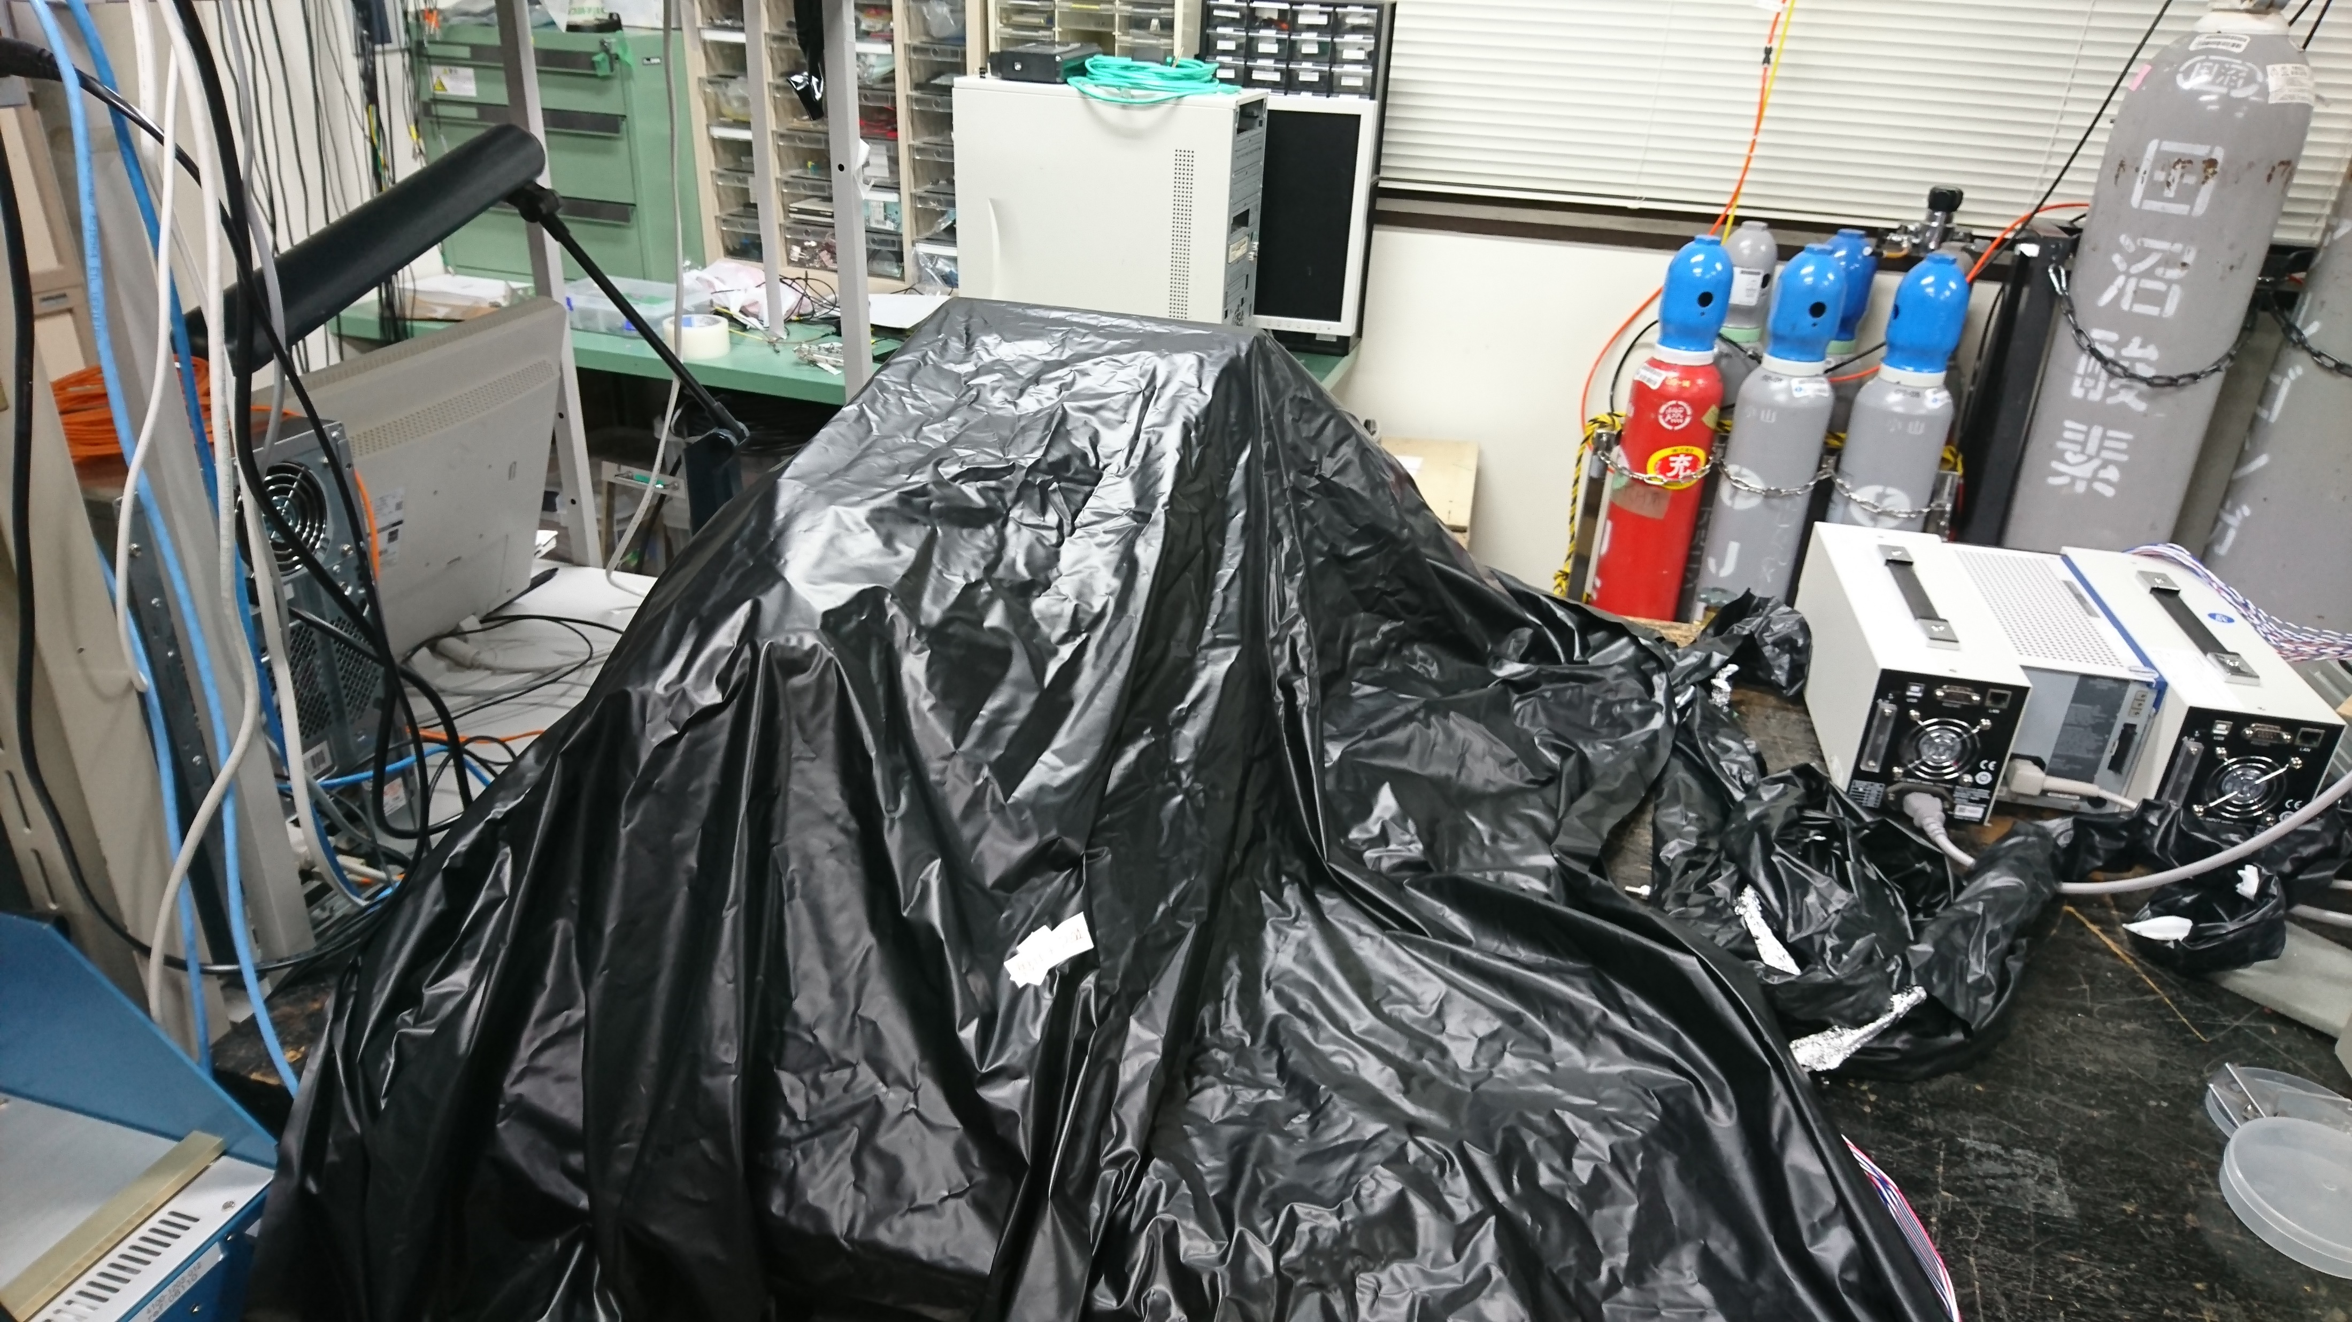
Restart ToF data taking
Data taking using cosmic-ray
Bias: 44.7V
Threshold (in mV)
R1: -58.2, R2: -35.2, L1: -78.6, L2: -51.4
1. 22.(Wed) 19:14~ data taking start

Slide 7
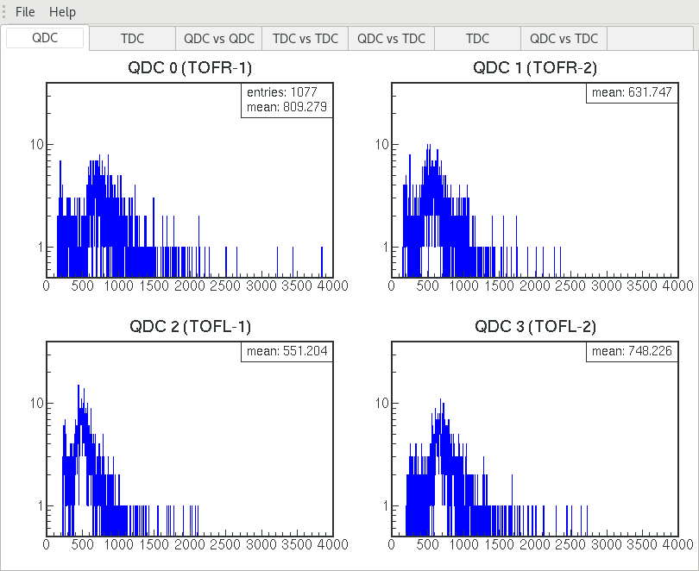
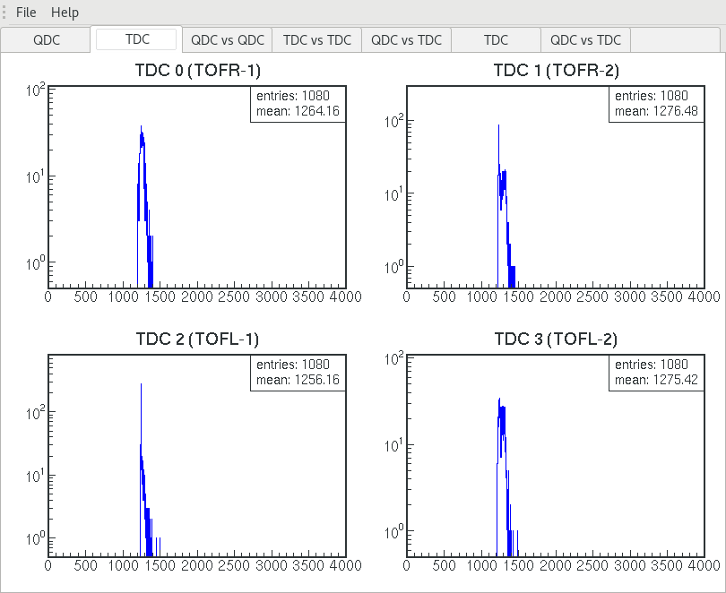
ToF: data taking w/ cosmic -status-
After ~200min, around 1000 events
01. 22. 22:35時点

Slide 8
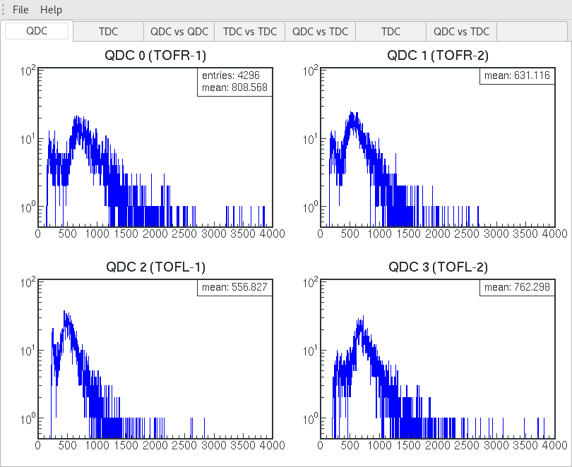
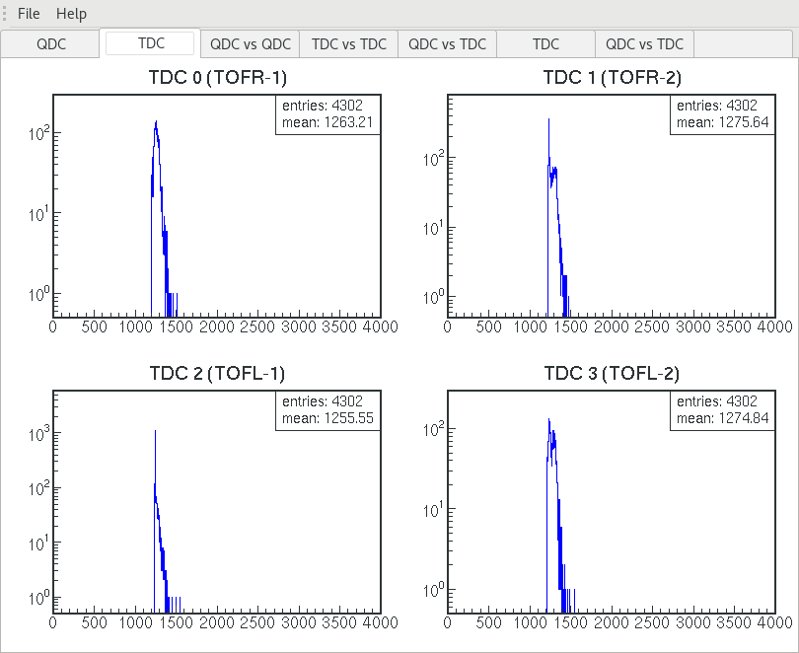
ToF: data taking w/ cosmic -status-
After ~13.5h, around 4300 events
01. 23. 08:40 (this morning) 時点

Slide 9
To do next
Check Beam time data under the same conditions
Design new circuit for MPPC
Test using different size scintillator (5*11*300 and 5*22*300 [mm])
Preparation for 中間発表

Slide 10
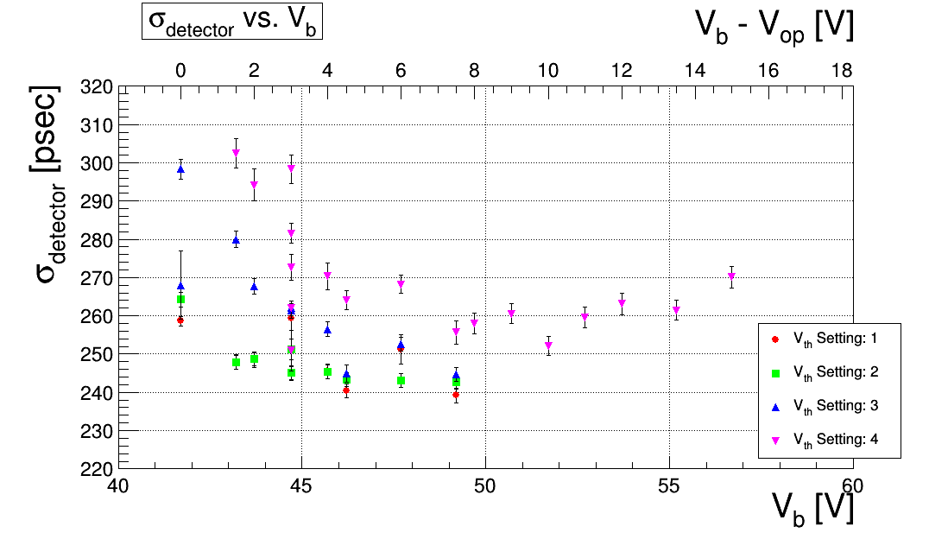
Bias dependence
w/ TDC-cut

Slide 11
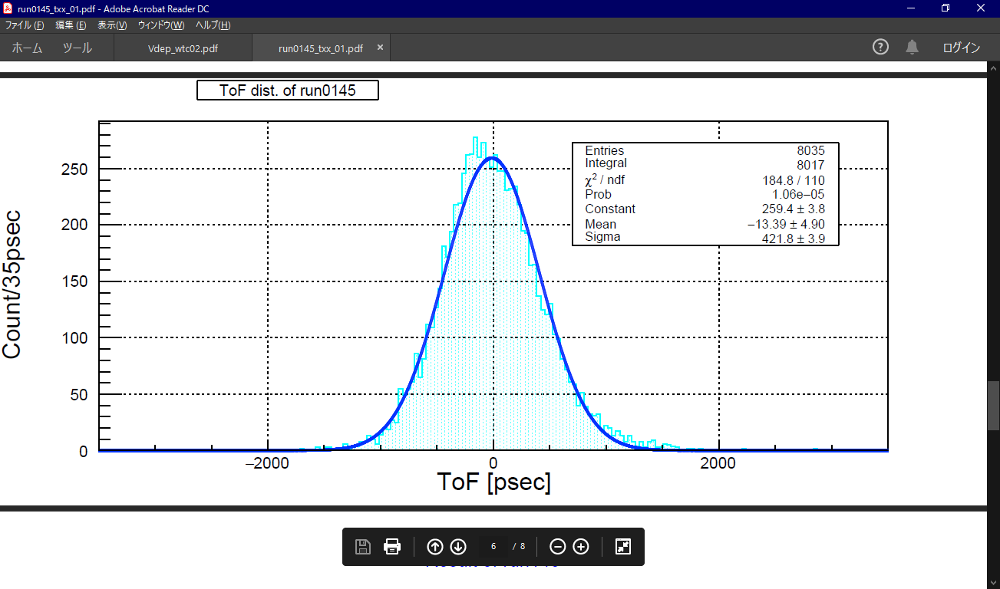
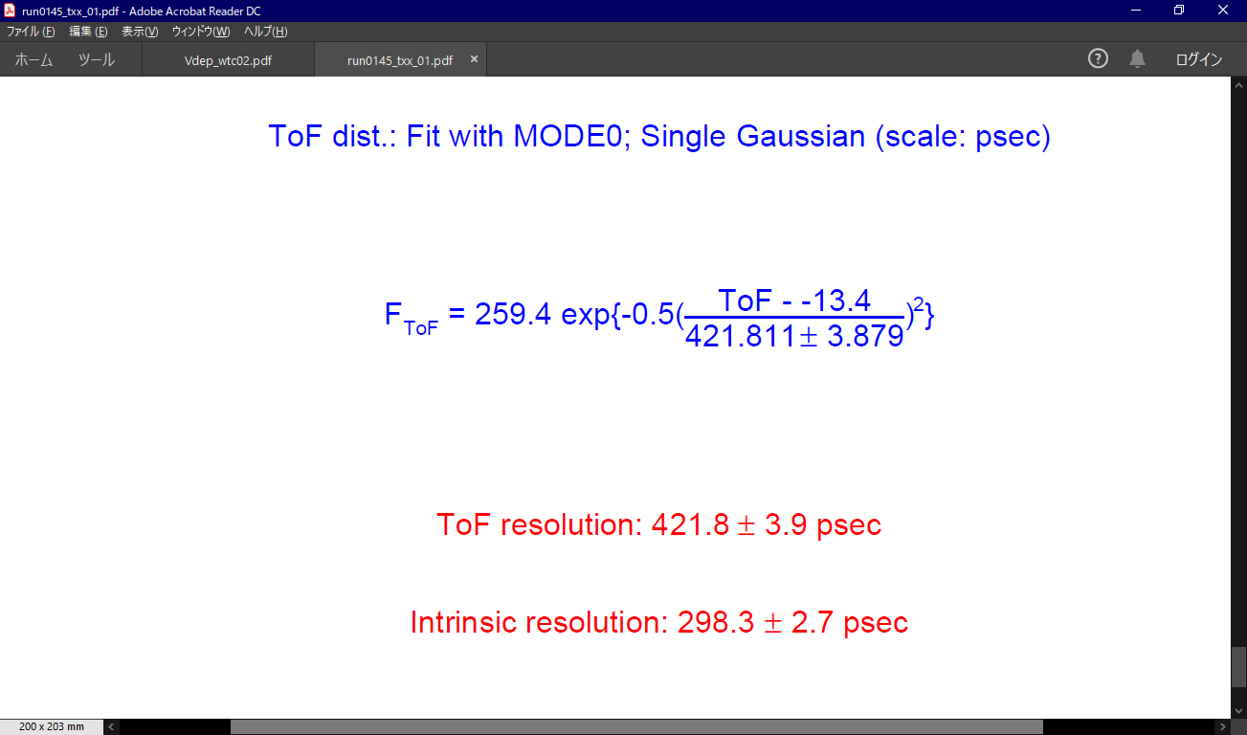

Slide 12
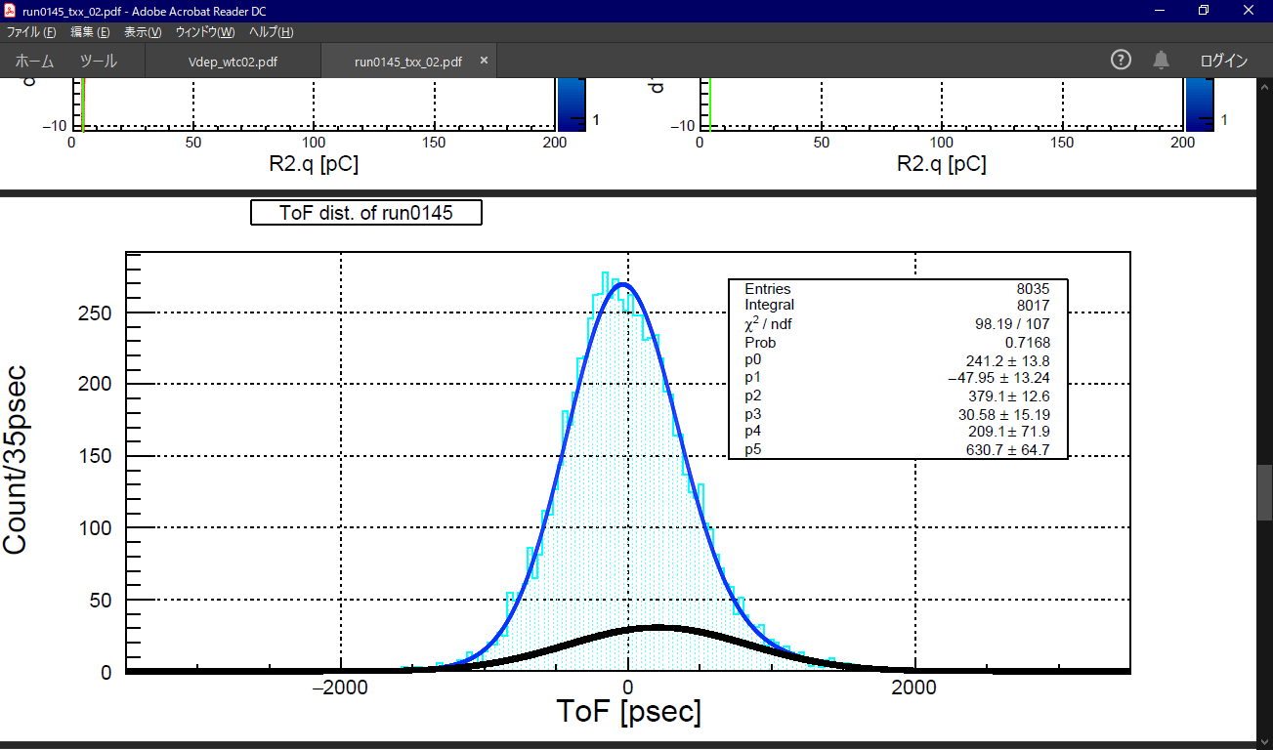
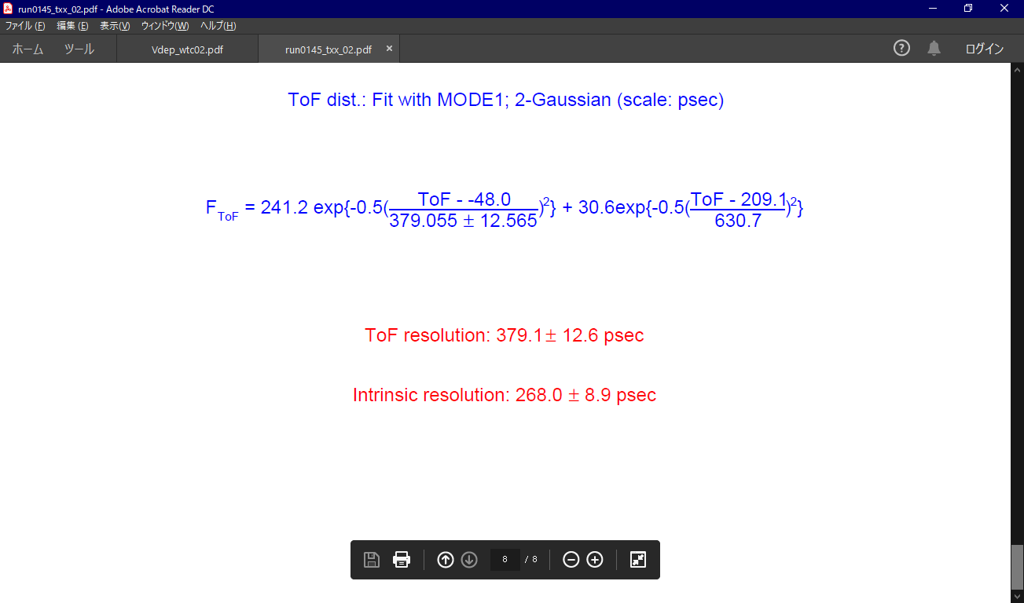
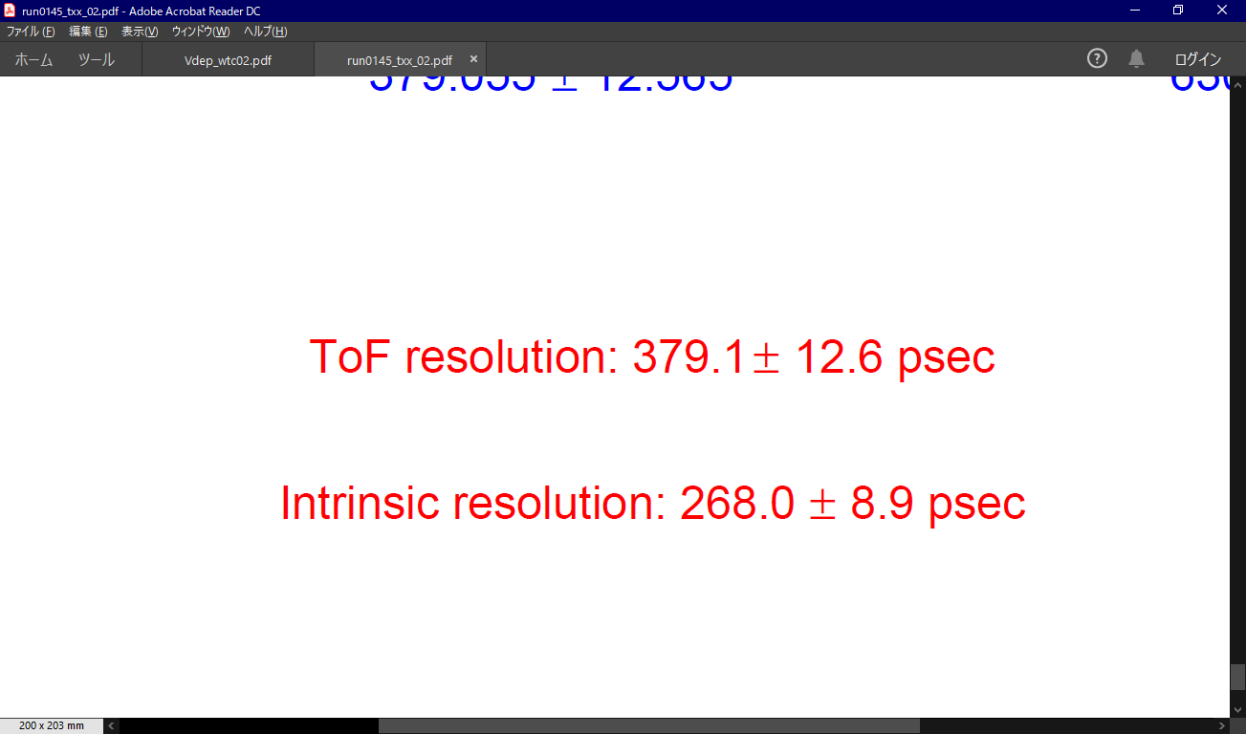

Slide 13
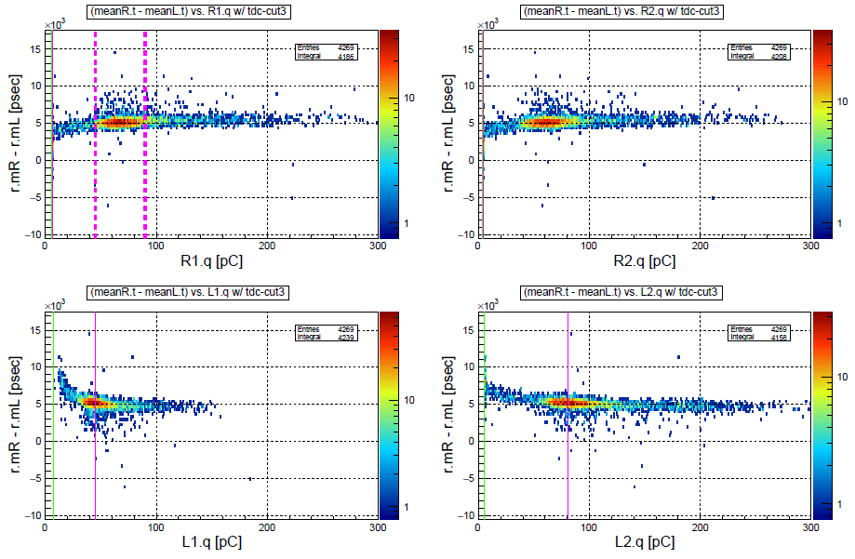

Slide 14


Slide 16
Vb=44.7
self. | sigma of ToF | Error of ToF | Intrinsic resolution | error of resolution
165 | 398.1 | 3.7 | 281.5 | 2.6
177 | 385.6 | 4.8 | 272.7 | 3.4
179 | 354.8 | 7.7 | 250.9 | 5.4
189 | 397.0 | 5.1 | 280.7 | 3.6
unit: psec
ref.num | 165 |  |  |  | 177 |  |  |  | 179 |  |  |  | 189
 | sigma of ToF | Error of ToF | Intrinsic resolution | Error of resolution | sigma of ToF | Error of ToF | Intrinsic resolution | Error of resolution | sigma of ToF | Error of ToF | Intrinsic resolution | Error of resolution | sigma of ToF | Error of ToF | Intrinsic resolution | Error of resolution
165 | 398.1 | 3.7 | 281.5 | 2.6 | 386.0 | 4.9 | 273.0 | 3.4 | 324.6 | 6.9 | 229.5 | 4.9 | 416.2 | 5.1 | 294.3 | 3.6
177 | 402.1 | 3.8 | 284.3 | 2.7 | 385.6 | 4.8 | 272.7 | 3.4 | 387.3 | 5.1 | 273.9 | 3.6 | 392.3 | 5.0 | 277.4 | 3.6
179 | 415.3 | 3.8 | 293.8 | 2.7 | 402.7 | 5.1 | 284.8 | 3.6 | 354.8 | 7.7 | 250.9 | 5.4 | 404.4 | 5.1 | 285.9 | 3.6
189 | 406.1 | 3.8 | 287.2 | 2.7 | 392.2 | 5.0 | 277.3 | 3.5 | 386.2 | 5.1 | 273.1 | 3.6 | 397.0 | 5.1 | 280.7 | 3.6

Slide 17
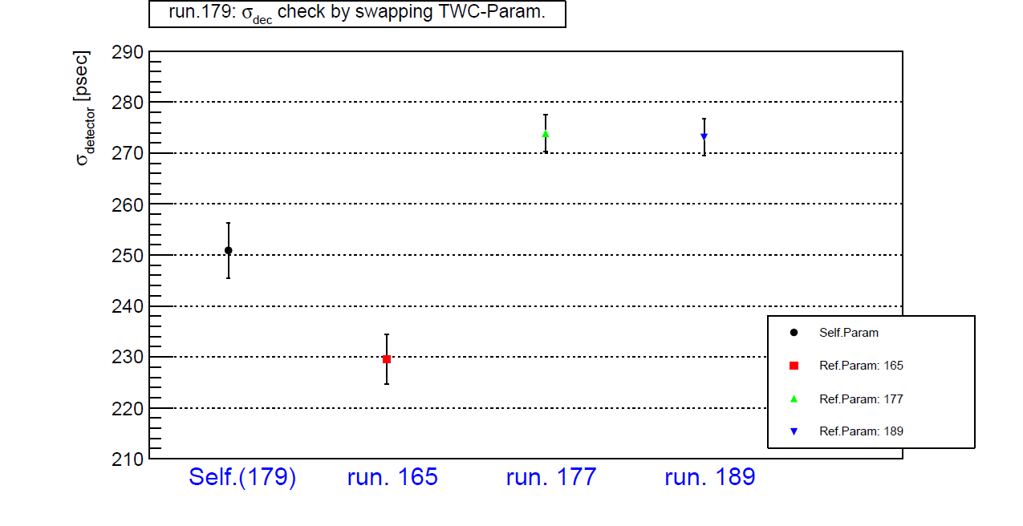

Slide 18
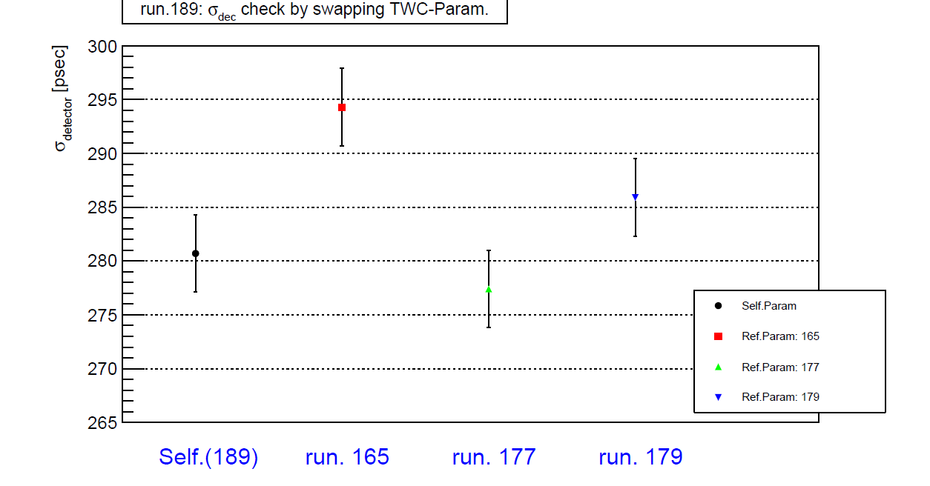

Slide 20
To do next
Bias study

